Slide 1
TypeScript

Slide 2
Agenda
▷ Introduction
▷ Installation
▷ Why TypeScript?
▷ Features
▷ Comparison With TypeScript Alternatives
▷ Who Uses TypeScript?
▷ Conclusion

Slide 3
1.
JavaScript
JavaScript that scales.

Slide 4
Overview
Javascript is formally known as EcmaScript (ES) the acronym of ECMA is European Computer Manufacturer's Association
The latest version of JavaScript is ES6 which was released on 2015 hence it is referred as ES2015 as well, but there are few newer releases in 2016 & 2017 which were officially referred as ES7 or ES2016 & ES8 or ES2017 respectively

Slide 5
ES6
The ES6 or ES6 script can’t understand by browser.
So it required transpiler, which help to convert ES6 or ES7 to ES5(JavaScript).
TypeScript transpiler
Babel transpiler
Traceur transpiler

Slide 6
1.
Introduction
JavaScript that scales.

Slide 7
“
TypeScript lets you write JavaScript the way
you really want to.
TypeScript is a typed superset of JavaScript that compiles to plain JavaScript.
Any browser. Any host. Any OS. Open Source.

Slide 8
Overview
▷ Syntax based on ECMAScript 4 & ECMASCript 6 proposals
▷ TS is first and foremost a superset of JS
▷ Any regular Javascript is valid TypeScript Code

Slide 9
“Microsoft's TypeScript may be the best of the many JavaScript front ends. It seems to generate the most attractive code.”
- Douglas Crockford
"CoffeeScript is to Ruby as TypeScript is to Java/C#/C++."
- Luke Hoban

Slide 10
TypeScript
TypeScript is a free and open source programming language developed and maintained by Microsoft.
It is a strict superset of JavaScript, and adds optional static typing and class-based object-oriented programming to the language.
It is designed for development of large applications and transpiler to JavaScript. As TypeScript is a superset of JavaScript, any existing JavaScript programs are also valid TypeScript programs.

Slide 11
2.
Installation
How to get it setup?

Slide 12
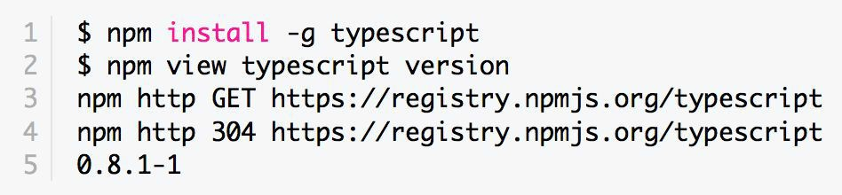
How To Install
For more details check: https://www.typescriptlang.org/docs/tutorial.html
Via npm (the Node.js package manager)
By installing TypeScript’s Visual Studio plugins
https://code.visualstudio.com/

Slide 13
3.
Why TypeScript?
Why everyone is using it more and more.

Slide 14
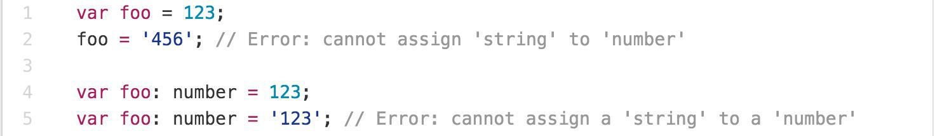
Main Goals of TypeScript
▷ Provide an optional type system for JavaScript.
▷ Provide planned features from future JavaScript editions to current JavaScript engines
▷ Modular Development

Slide 15
4.
Features
What makes TypeScript super awesome

Slide 16
TypeScript Features
▷ Data Types Supported
▷ Optional Static Type Annotation
▷ Classes
▷ Interface
▷ Modules
▷ Arrow Expressions
▷ Type Assertions
▷ Ambient Declarations
▷ Source File Dependencies

Slide 17
Data Types

Slide 18
Variable declaration
In ES6, we can use var, let and const keyword to declare the variable.
var keyword is used to declare the function scoped variable.
let keyword is used to declare the block scoped variable.
const keyword is used to declare the constant value.

Slide 19
▷ Any
▷ Primitive
Number
Boolean
String
Void
Null
Undefined - Same as JS
▷ Array
▷ Enum

Slide 20
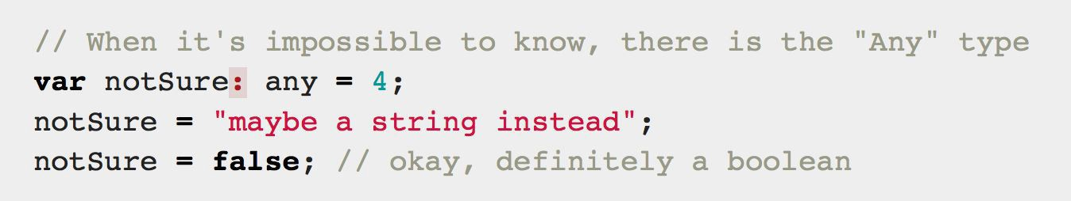
Any
Any is used when it’s impossible to determine the type

Slide 21
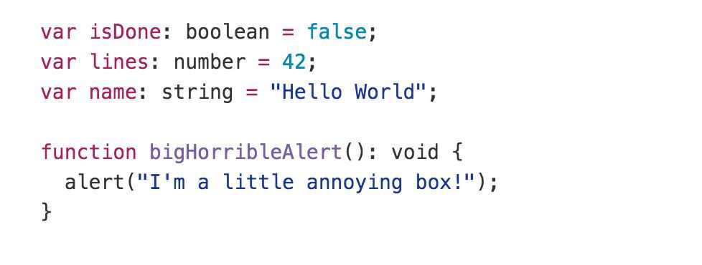
Primitive
▷ Doesn’t have separate integers and float/double type. These all are floating point values and get the type ‘number’
▷ boolean - true/false value
▷ string - both single/double quote can be used
▷ No separate char type
▷ void - is used in function type returning nothing
▷ null and undefined - functions as usual

Slide 22
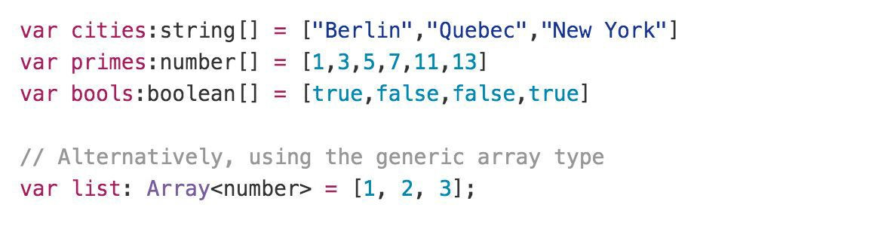
Array

Slide 23
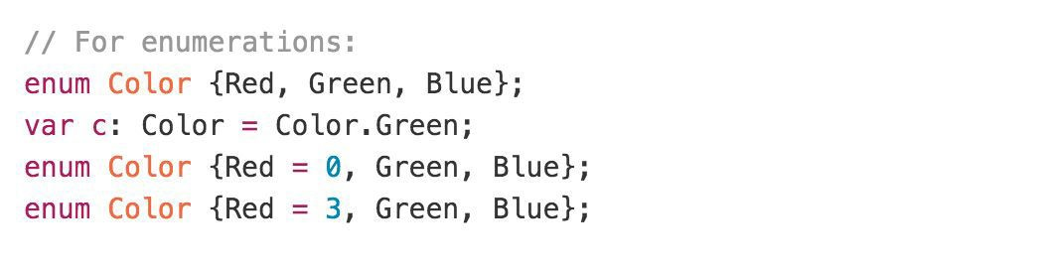
Enum
By default, enums begin numbering their members starting at 0. You can change this by manually setting the value of one its members.

Slide 24
TypeScript functions
Normal function
Function with parameter
Function with parameter variable with datatype
Function with return types.
Function with required parameter
Function with default parameters
Function with optional parameters

Slide 25
Continue...
Rest parameter
Spread parameter
Arrow function (lambda expression)

Slide 26
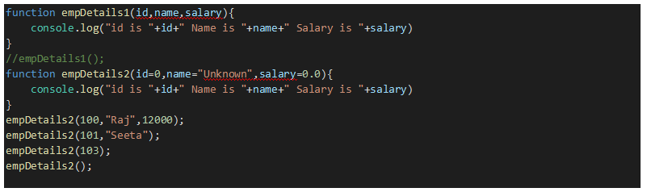
Default parameter sample

Slide 27
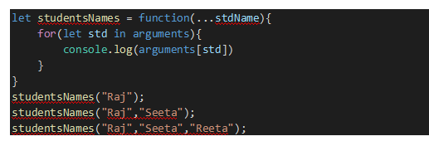
Rest Operator
RestParameter is use to take or receive the variable number of parameter and put into a single array.

Slide 28
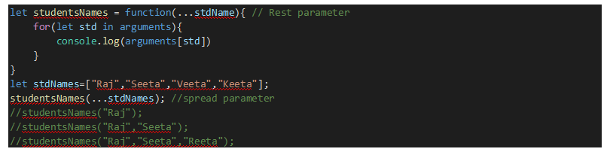
Spread parameter
Spread parameter is used to takes an array and put individual to elements or variable.

Slide 29
Rest Parameter Vs Spread parameter
Rest Parameter declare inside the function declaration and spread parameter declared while calling the function.

Slide 30
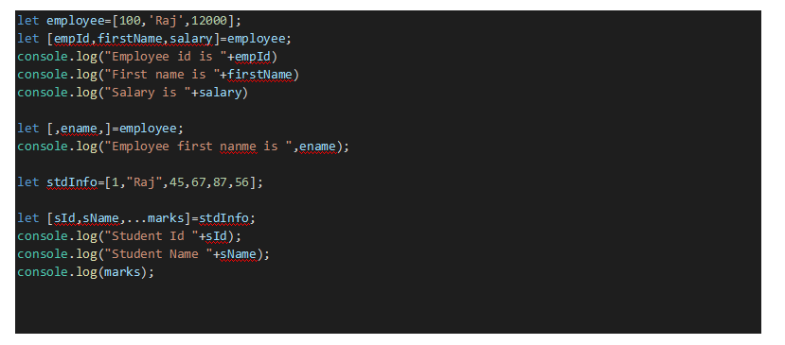
Destructing the Array

Slide 31
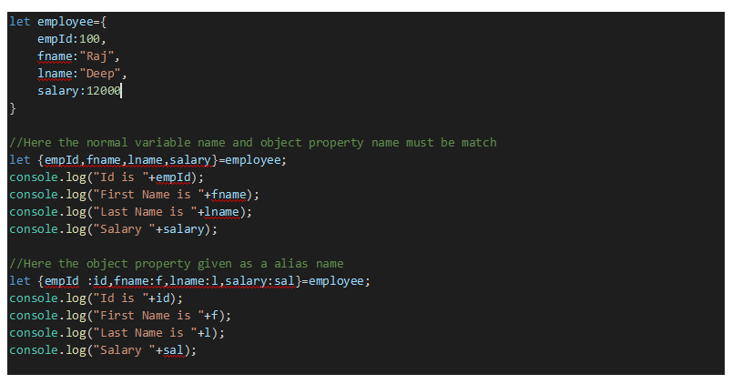
Destructs the objects' property

Slide 32
ES6 String
let msg1=“Simple Msg”; //double quote
let msg2=‘Simple Msg’; // single quote
let msg3=`Simple Msg`;//backticks quote
let name =“Raj Deep”;
let msg4 = `The name is
${name} `; //string template

Slide 33
Different way for loop
let abc:string[]=[“a”,”b”,”c”,”d”]
First way
for(let i=0;i<abc.length;i++){
console.log(abc[i])
}
Second way
for(let index in abc) {
console.log(abc[index])
}

Slide 34
Continue...
Third way
for(let val of abc) {
console.log(val)
}
Fourth way
abc.forEach(function(value){
console.lot(value)
})

Slide 35
using arrow function
Fifth way
abc.forEach((value)=>console.log(value))

Slide 36
Classes

Slide 37
TypeScript Classes
▷ Can implement interfaces
▷ Inheritance
▷ Instance methods/members
▷ Static methods/members
▷ Single constructor
▷ Default/Optional parameter
▷ ES6 class syntax

Slide 38
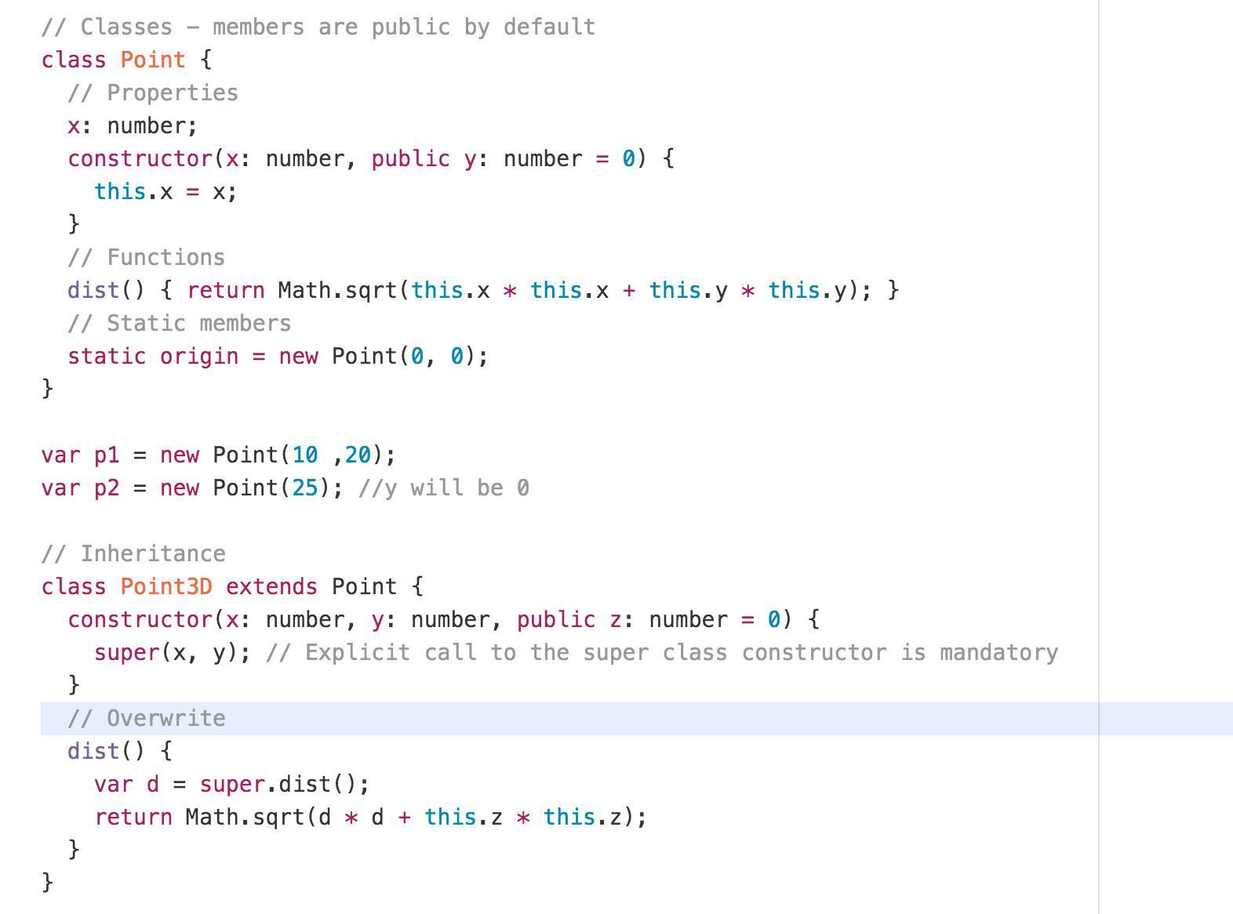
TypeScript Classes Example

Slide 39
Inheritances

Slide 40
TypeScript Interfaces
▷ Declared using interface keyword
▷ Like other TS features it’s design time features i.e. no extra code would be emitted to resultant JS file
▷ Errors being shown when interface signature and implementation doesn’t match.

Slide 41
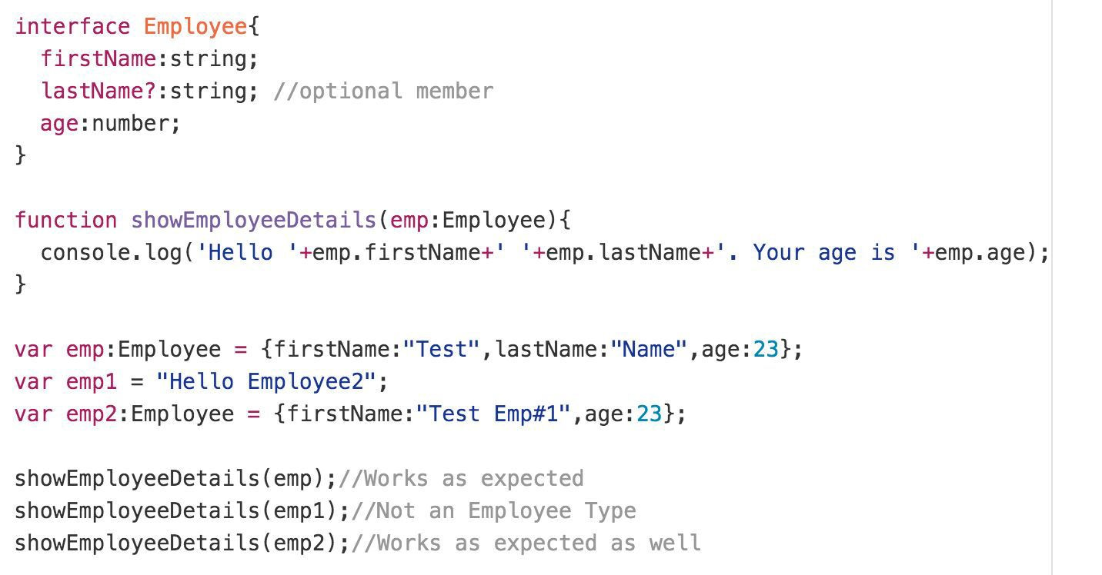
TypeScript Interfaces Example

Slide 42
Modules

Slide 43
Modules
Modules can be defined using module keyword
A module can contains sub-modules, class, enum or interfaces. But can’t directly contains functions.
Modules can be nested(sub-modules).
Classes and Interfaces can be exposed using export keyword.

Slide 44
Types of module
Internal module
External module

Slide 45
Source File Dependencies
Can be done using reference keyword
Must be the first statement of file
Paths are relative to the current file

Slide 46
Sample Example internal module
a.ts
module A{
export function abc(){
console.log("Abc function from a.ts")
}
}
b.ts
module B {
export function abc() {
console.log("Abc function from b.ts")
}
}
main.ts
///<reference path="./a.ts"/>
///<reference path="./b.ts"/>
A.abc();
B.abc();

Slide 47
Sample Example external module
a.ts
export function abc(){
console.log("Abc function from a.ts")
}
b.ts
export function abc() {
console.log("Abc function from b.ts")
}
}
main.ts
import {abc} from "./a";
import {xyz} from "./b";
abc();
xyz();

Slide 48
6.
Who Uses TypeScript?

Slide 49




Companies use TypeScript

Slide 50
7.
Conclusion

Slide 51
Conclusion
Pros:
▷ High value, low cost improvement over JavaScript
▷ Safer and more modular
▷ Solid path to ECMAScript 6
Cons:
▷ Still need to know some JS quirks
▷ Current compiler slowish(Faster one is in development)

Slide 52
Thanks!
Any questions?

